Slide 1
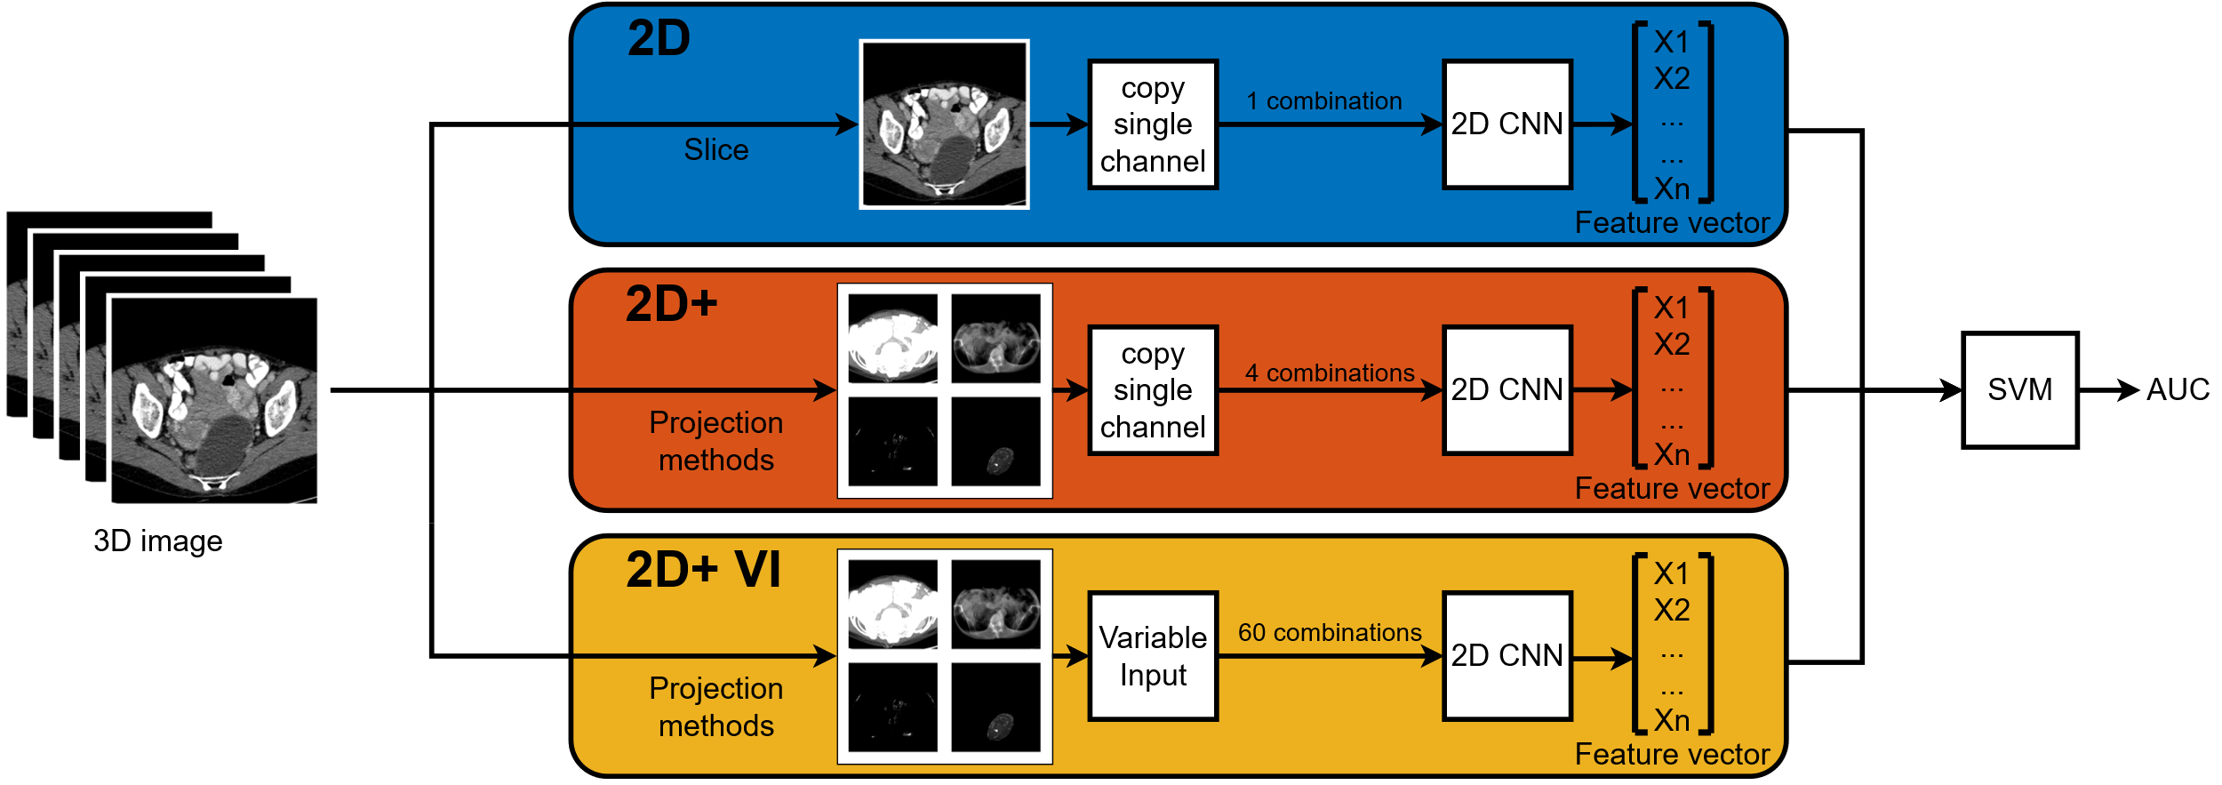
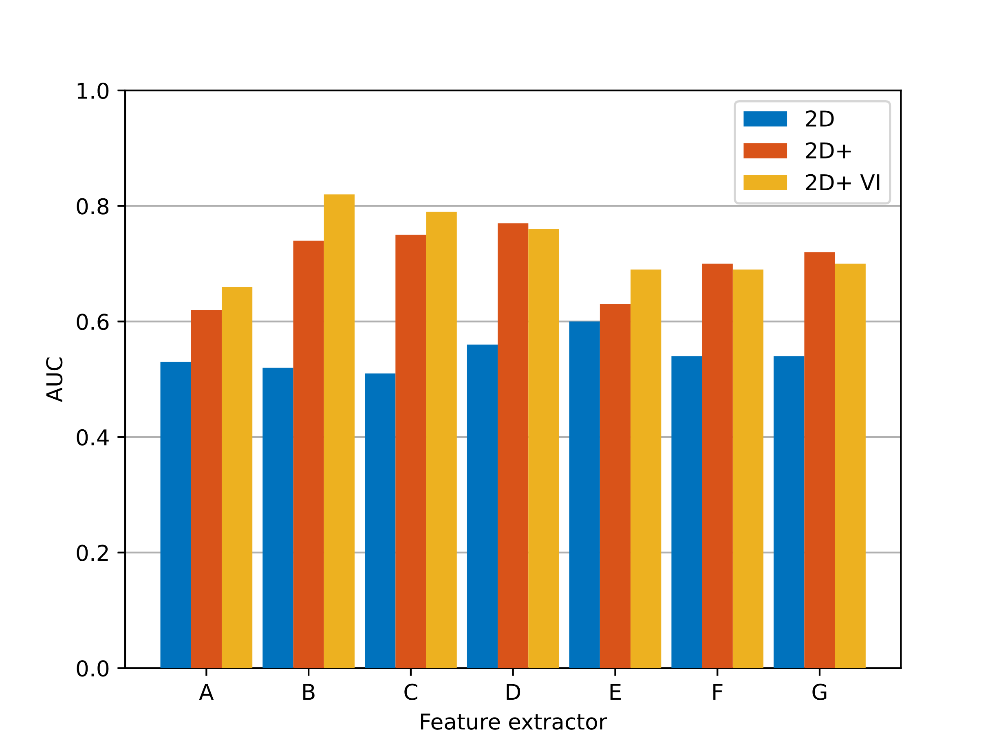
Improving 2D CNN based feature extraction of 3D
CT scan images for ovarian cancer
Sven Bierenbroodspot
Introduction
Ovarian cancer, often diagnosed late, claims over 1000 lives annually in the Netherlands. Radiographic imaging, including CT and MRI scans, aid doctors with tumor classification in order to reach high accuracy. Inspired by successful AI applications in lung cancer, this study explores the applicability of AI techniques, specifically 2D CNNs, in ovarian cancer classification. This study aims to improve 2D CNN based feature extraction of 3D images. This is achieved through projection techniques to include 3D information on 2D projections.
Results
Methods
The 3D images are obtained from the Catharina hospital in Eindhoven. These images contain a tumor outline as well as a label.
Projection methods
Maximum Intensity Projection (MIP)
Average Intensity Projection (AIP)
Tumor MIP
Minimum intensity Projection (MINIP)
Input methods:
2D The most basic method is used as the baseline to improve on. Here a single slice of the image is taken and copied into the feature extractor.
Figure 2: Classification AUC score over 5-fold cross validation for methods using all feature extractors and input methods. The input methods are arranged from least involved to most involved. For input methods with more than 1 combination, the maximum AUC of all combinations is displayed. Each letter on the feature extraction axis represents a different 2D CNN.
Conclusion
For all different feature extractors, using the 2D+ input method was able to improve compared to the 2D input method. Some feature extractors saw a more significant increase than others. The variable input was able to increase performance upon the 2D+ method for some feature extractors but not for all. This study shows considerable improvement on 2D CNN based feature extraction.
2D+ This method includes the projection methods copied into the feature extractor.
2D+ VI This method includes the projection methods with variable input combinations for the feature extractors.
DEPARTMENT OF ELECTRICAL ENGINEERING

